Slide 1
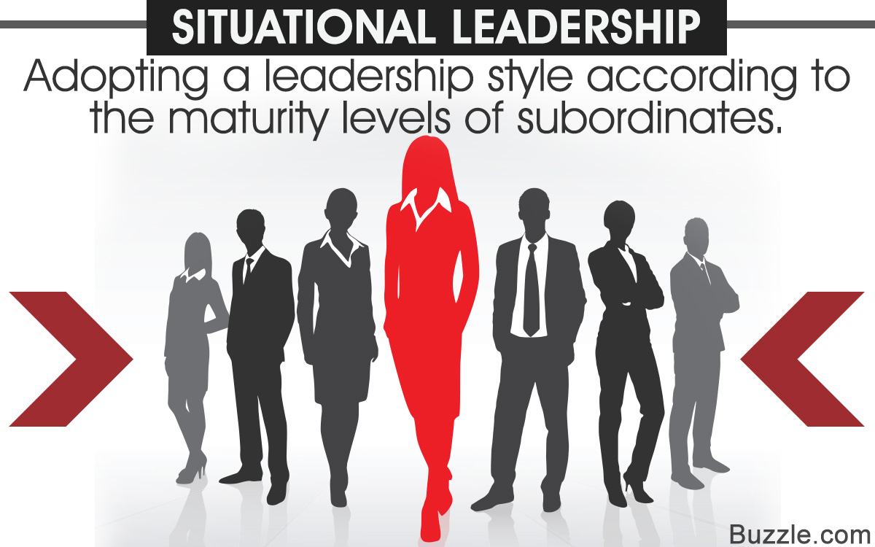

Slide 2
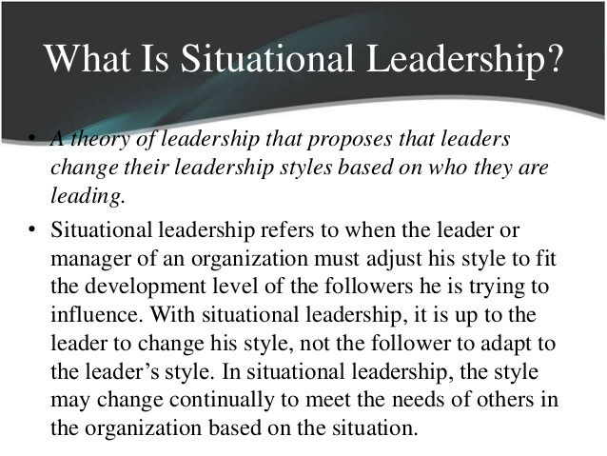

Slide 3
Situational Leadership Theory
Situational Leadership Theory, or the Situational Leadership Model, is a model created by Paul Hersey and Ken Blanchard, developed while working on Management of Organizational Behavior. The theory was first introduced in 1969 as "life cycle theory of leadership".

Slide 4
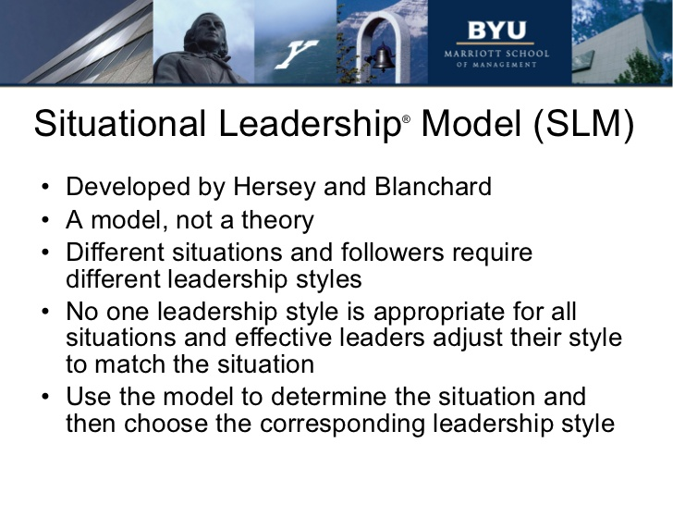

Slide 5
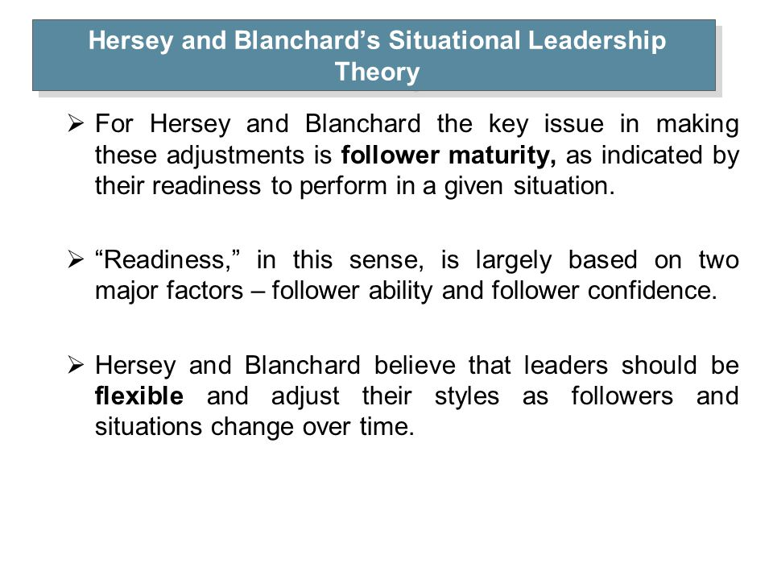

Slide 6
What Is the Situational Leadership Theory?
The situational leadership theory stresses that different situations demand different kinds of leadership.
Situational leadership is flexible. It adapts to the existing work environment and the needs of the organization.
Situational Leadership is not based on a specific skill of the leader; instead, he or she modifies the style of management to suit the requirements of the organization.

Slide 7
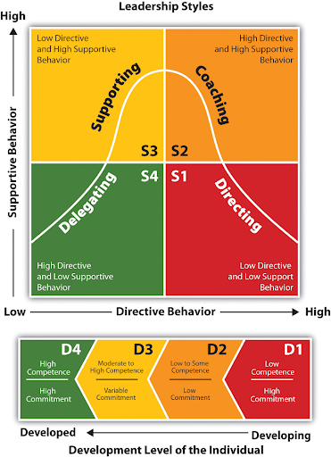
Situational Leadership
The four leadership styles are called: Directing, Coaching, Supporting and Delegating. In terms of the four leadership styles: Directing is high on directing behavior, but low on supporting behavior. Coaching is high on both directing and supporting behavior.

Slide 8
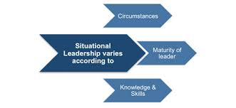

Slide 9
How do you use SLM?
Steps to Apply Situational Leadership Model
Determine the nature of the situation.
Understand the nature and complexity of the task at hand.
Evaluate the skills and the desire of the subordinates to do the task being asked to perform

Slide 10
High Level of Effectiveness of SLM: How?
The situational theory of leadership refers to those leaders who adopt different leadership styles according to the situation and the development level of their team members.
It is an effective way of leadership because it adapts to the team's needs and sets a beneficial balance for the whole organization.
The essence of situational leadership is that effective leaders should tailor their style according to the situation - the nature of the task and the skills, preferences and experience of the people they are leading

Slide 11
Advantages and Disadvantages of SLM
Advantages
It recognizes the need for flexibility.
It creates a comfortable environment for workers.
It takes different developmental phases into account
It increases the awareness of the leader.
It helps a team be able to work better together.
It helps a team be able to work better together.
Disadvantages
It focuses more on immediate needs than long-term needs.
It can be ineffective in task-orientated environments.
It can be challenging to define maturity.
It does not provide enough information for some leaders.
It is based on the skill level of the leader.
It creates a corporate dependency.
It may create confusion within the company.

Slide 12
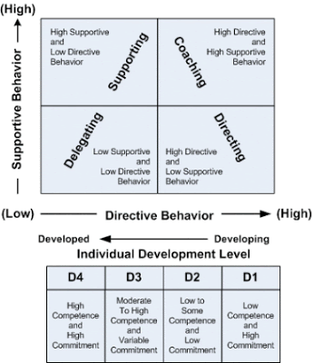
Two Major Components of SLM: 1. Directive Dimension (Task) 2. Supportive Dimension (Relationship)

Slide 13
Key points of SLM
The Hersey-Blanchard Situational Leadership Theory is one that is based around variable leadership, depending on a variety of circumstances.
The four leadership styles that are presented in this theory are Telling, Selling, Participating, and Delegating.
To go along with those four leadership styles, the Hersey Blanchard Situational Leadership Theory also provides four maturity levels that describe those who are making up the team.
At a maturity level of M1, team members need to be instructed on how to do just about everything that makes up the task they are responsible for.
At a maturity level of M2, team members are those who are more eager to work on a job, even if they aren't yet ready to do it correctly without the help of the leader of the group.
At a maturity level of M3, team members might not be able to quite get all of the job done without some help, but they can get most of the way their on their own.
At a maturity level of M4, team members are completely capable of handling a task and they know that they can get the job done without the help of the leader.
The Hersey Blanchard Situational Leadership Theory promotes flexible leaders that are able to match their style to the experience and ability of those they are leading.

Slide 14

Situational Leadership: Listening

Slide 15


